Slide 1
SIGN Language To Text Language

Slide 2

Malla Reddy Collage Of Engineering And Technology (Autonomous Institution- UGC, Govt. of India) Affiliated to JNTUH, Hyderabad
Internal Guide:
Mrs. B.JYOTHI
Department of CSE(AIML)
project Team Members:
T.vijeswar Reddy (22N31A66H6) P.Hussain setty (22N31A66D9) Y.Rajasekhar Reddy (22N31A66J6)

Slide 3

CONTENTS:
Abstract
Introduction
Existing System
Existing System Drawbacks
Proposed System
Proposed System Advantages
Architecture diagram
UML Diagrams
Conclusion
References

Slide 4

ABSTRACT:
Sign language is a vital means of communication for the Deaf and hard of hearing communities. However, the language barrier between sign language users and those who do not understand it often poses significant communication challenges. This project presents a novel system for sign language-to-text conversion.
The proposed system utilizes advanced computer vision techniques to accurately recognize and translate sign language gestures into written text. A convolutional neural network (CNN) is employed for hand gesture detection and classification, while a recurrent neural network (RNN) processes the sequence of gestures to generate coherent text.
The system is trained on a comprehensive dataset encompassing various sign language gestures, ensuring high accuracy and robustness. Experimental results demonstrate the efficacy of the approach, with the system achieving a high recognition rate and efficient performance. This technology holds promise for enhancing accessibility and inclusivity, enabling more effective communication for sign language users in diverse settings.

Slide 5

INTRODUCTION:
Communication is important for everyone. For people who are deaf or hard-of-hearing, sign language is a key way to communicate. However, many people do not understand sign language, which can make communication difficult.
The Sign Language to Text Language project aims to solve this problem by creating a tool that translates sign language into written text in real-time.
This project uses advanced technology to recognize hand gestures and convert them into text instantly. This way, people who use sign language can easily communicate with those who do not understand it. The main goals are to make communication easier and improve accessibility and create a tool that can be used on different devices like phones and computers.

Slide 6
Existing System:
There are many existing systems for translating sign language to text, including:
DeepLearningComputerVision: A model that uses Deep Neural Network architectures to recognize hand gestures and generate corresponding English text.

Slide 7
Existing System drawbacks:
Facial expressions and lip movements: Many systems have difficulties in recording hand and finger movements and an inability to capture facial expressions, lip movements, and eye movements.
Accessibility: Many systems rely on specialized hardware or apps, which may not be accessible to all users.

Slide 8
Proposed System:
A proposed sign language recognition system to text language can use image processing to analyze live sign gestures, classifiers to differentiate signs, and machine learning algorithms to train on data sets. The system can have multiple processing stages, such as: hand and head segmentation, hand and head tracking, feature extraction, and gesture pattern classification.

Slide 9
ADVANTAGES:
Improved Communication
Inclusivity
Education and Training
Emergency Situations

Slide 10
REQUIREMENTS:
Hardware Requirements :
processor: i3 or i5
Hard Disk : 1 TB.
Monitor : 14’ Color Monitor.
Mouse : Optical Mouse.
RAM : 4GB.
Software Requirements:
Operating system : Windows 10.
Coding Language : Python.
Front-End : Html,Css,javascript.
Back-End:python

Slide 11
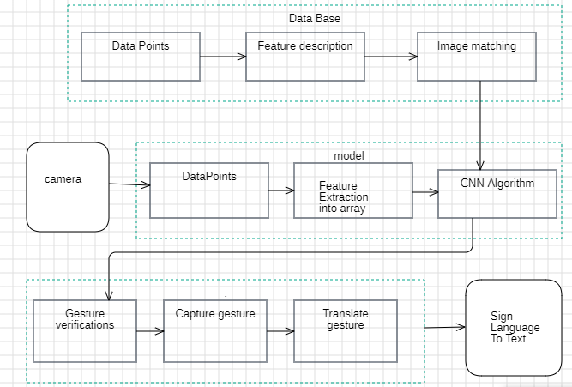
Architecture diagram:

Slide 12
Uml diagrams:
1.Use case diagram
2.Class diagram
3.Sequence diagram
4.Activity diagram

Slide 13
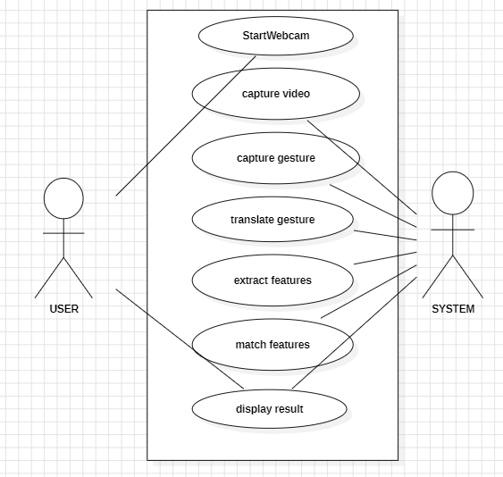
Use case diagram: A use-case diagram in the Unified Modeling Language (UML) is a type of behavioral diagram defined by and created from a Use-case analysis. Its purpose is to present a graphical overview of the functionality provided by a system in terms of actors, their goals (represented as use cases), and any dependencies between those use cases. The main purpose of a use case diagram is to show what system functions are performed for which actor. Roles of the actors in the system can be depicted. A gesture refers to a movement made by a part of the body, especially the hands or the head, to express an idea, sentiment, or attitude.

Slide 14
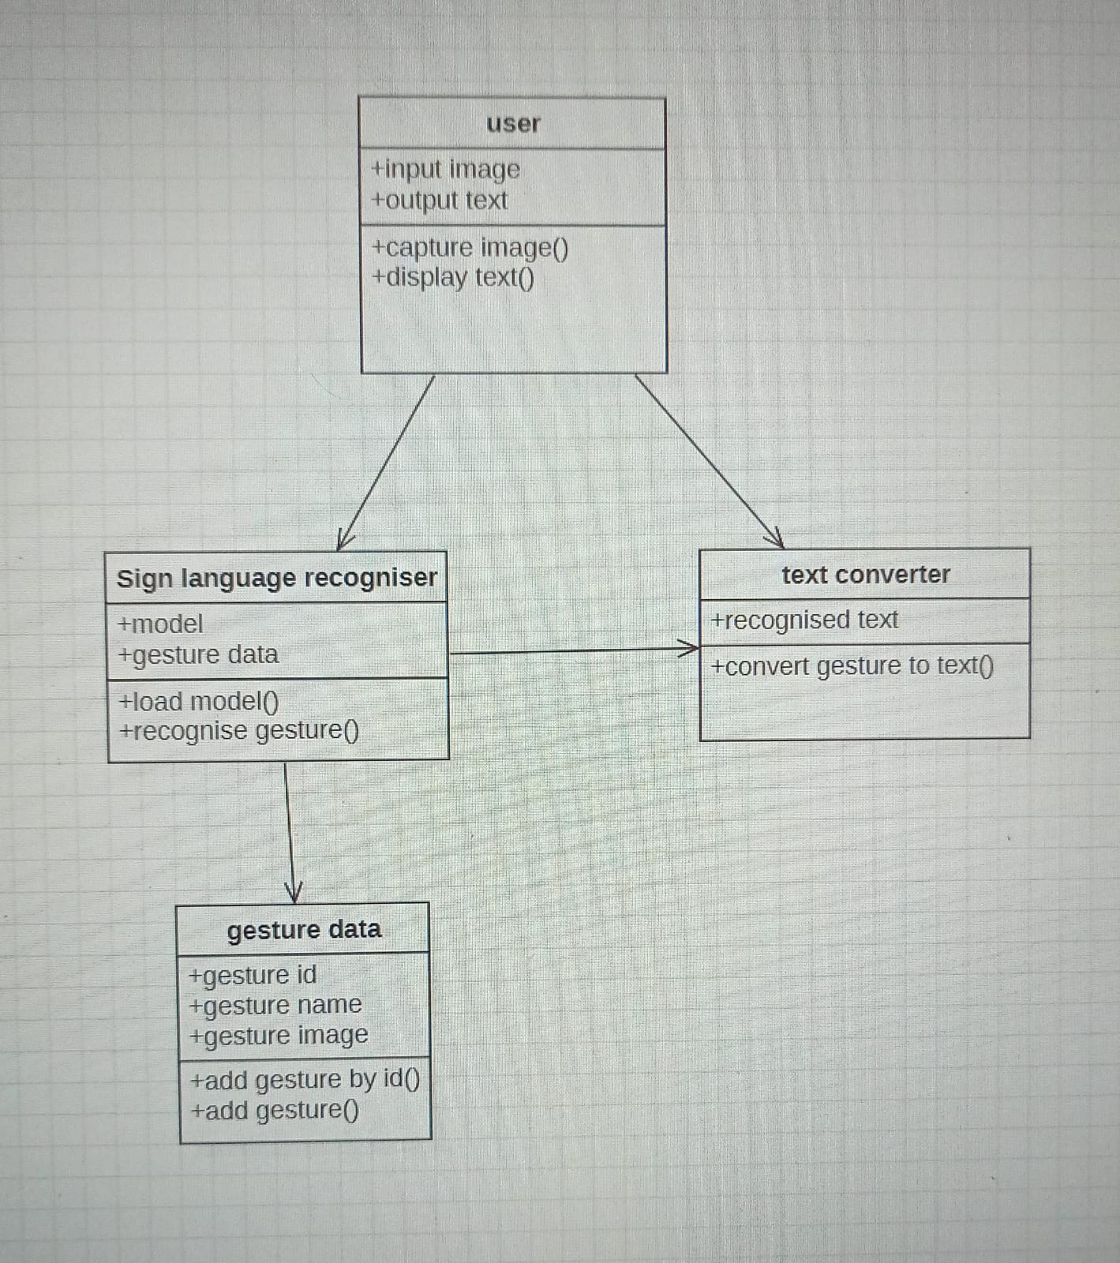
Class diagram:
In software engineering, a class diagram in the Unified Modeling Language (UML) is a type of static structure diagram that describes the structure of a system by showing the system's classes, attributes, operations (or methods), and the relationships among the classes. It explains which class contains information.

Slide 15
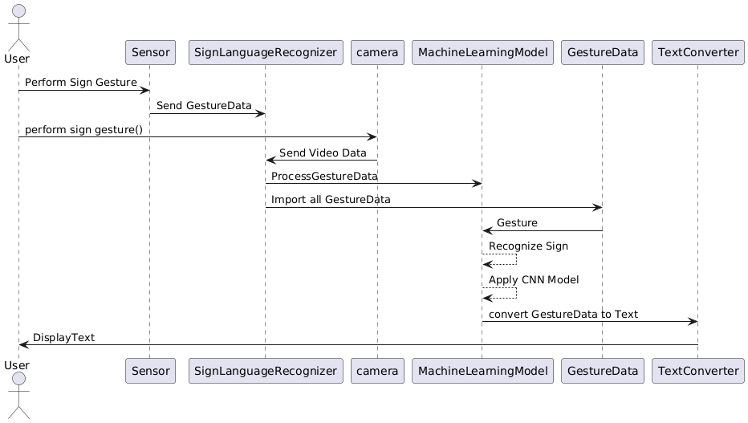
Sequence diagram:
A sequence diagram in Unified Modeling Language (UML) is a kind of interaction diagram that shows how processes operate with one another and in what order. It is a construct of a Message Sequence Chart. Sequence diagrams are sometimes called event diagrams, event scenarios, and timing diagrams

Slide 16
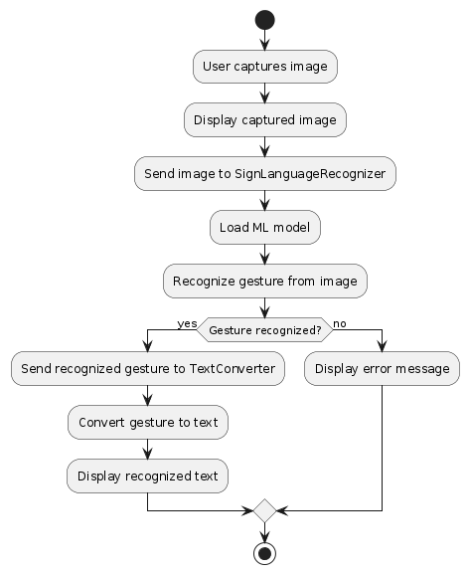
ACTIVITY DIAGRAM:
Activity diagrams are graphical representations of workflows of stepwise activities and actions with support for choice, iteration and concurrency. In the Unified Modeling Language, activity diagrams can be used to describe the business and operational step-by-step workflows of components in a system. An activity diagram shows the overall flow of control.

Slide 17
Conclusion:
Sign language recognition systems aim to convert sign language into text or speech to help deaf and hearing people to communicate. However, this task is difficult because of the complexity and large variation of hand movements, body postures, and facial expressions involved, which often incorporate rapid and complex movements.

Slide 18
Reference:
Tiago Oliveira et al., "Automatic sign language translation to improve communication", 2019 IEEE Global Engineering Education Conference (EDUCON), 2019.
Mahesh Kumar NB, "Conversion of sign language into text", International Journal of Applied Engineering Research, vol. 13, no. 9, pp. 7154-7161, 2018.
Aarons, D. (1994). Aspects of the Syntax of American Sign Language. PhD dissertation, Boston University.
Aarons, D.Bahan,B.Kegl,J.Neidle,(1992). Clausal structure and a tier for grammatical marking in American Sign Language. Nordic Journal of Linguistics, 15, 103–142.

Slide 19


